Slide 1
Applications of Daily Life Sampling to Aging and Emotion
Dr. Tabea Springstein
Assistant Professor
University of California, Riverside

Slide 2
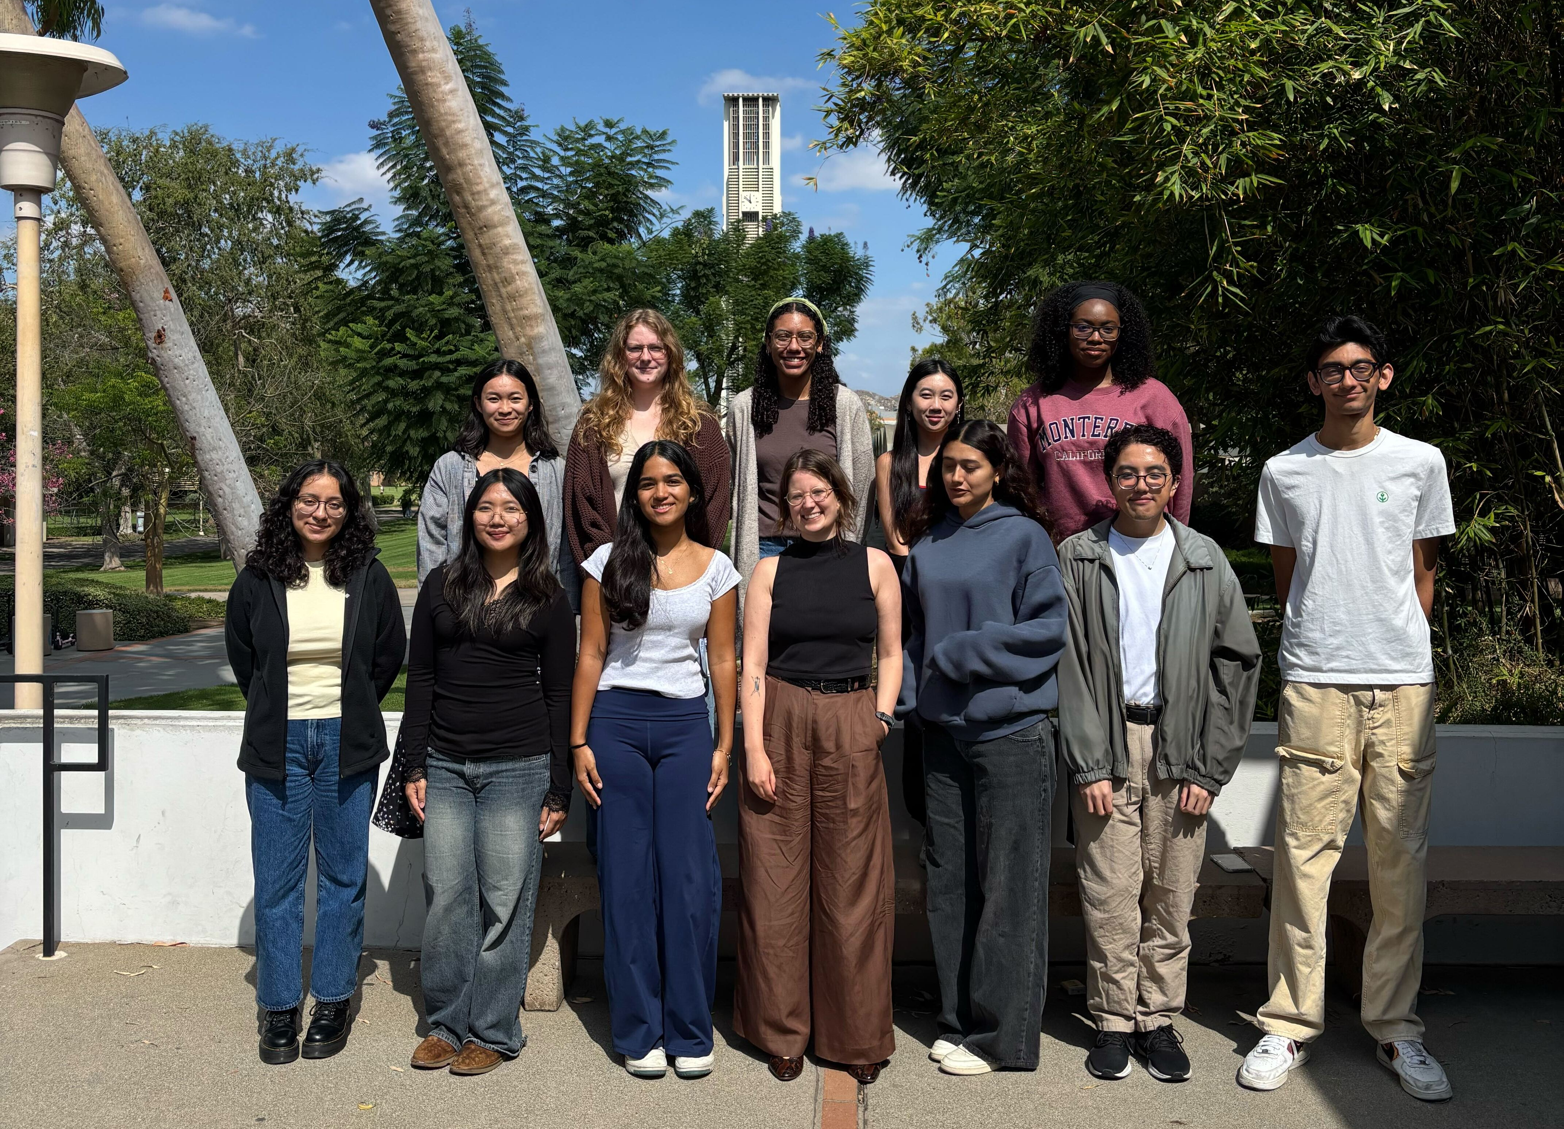


About me

Slide 3
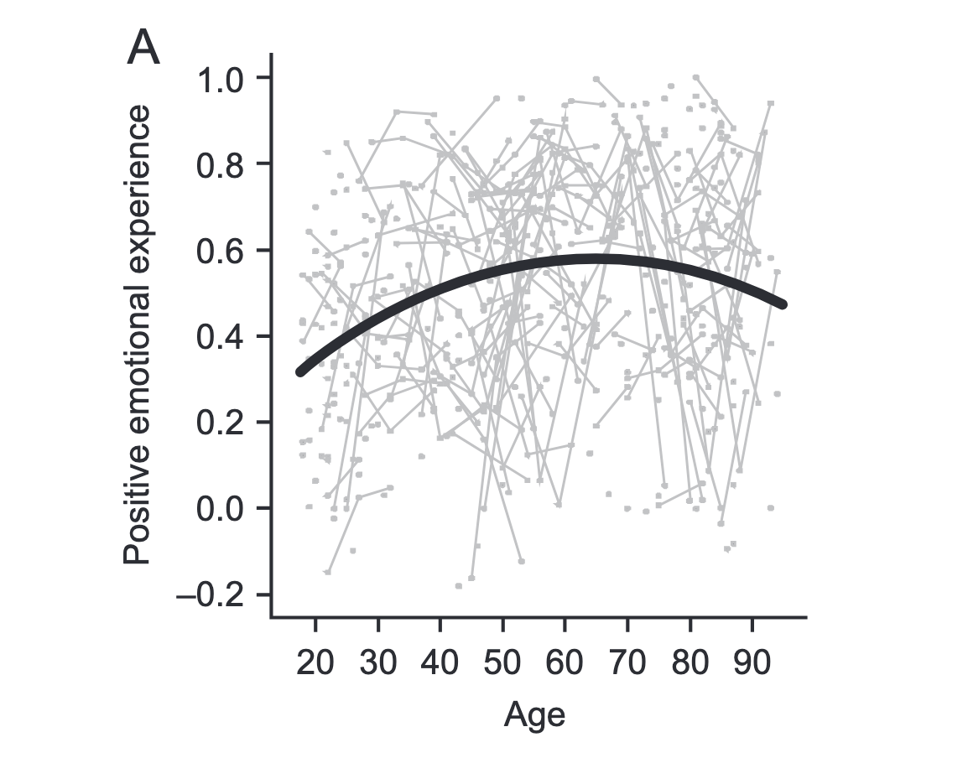
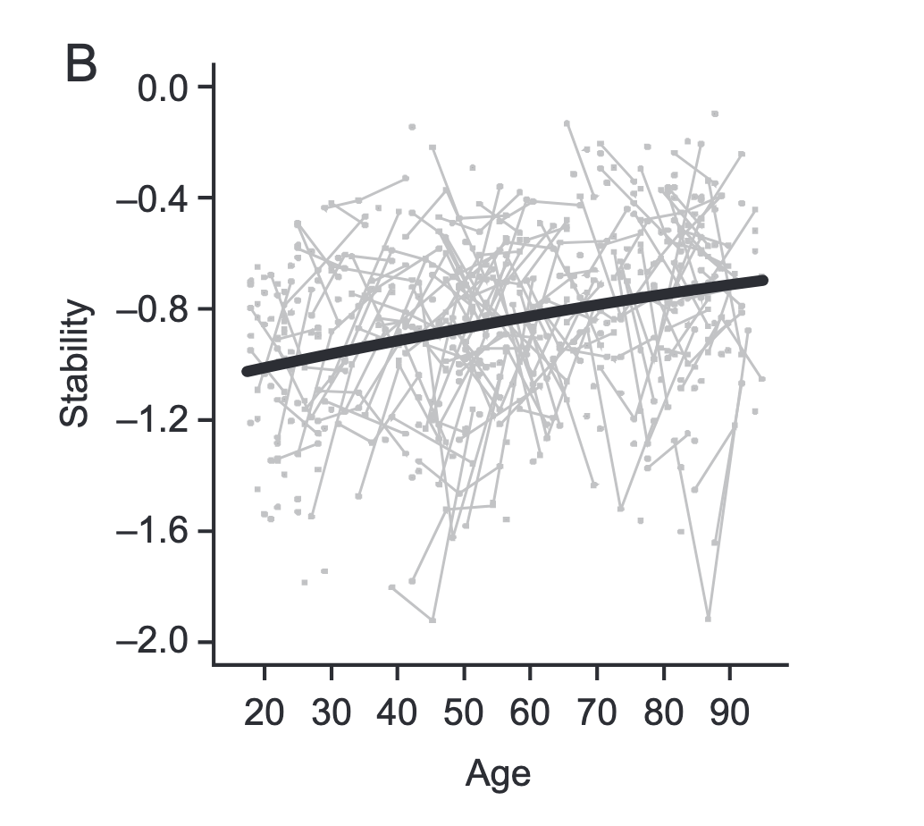

Emotions and Aging
More positive Emotions
More stable Emotions
Carstensen et al., 2011

Slide 4
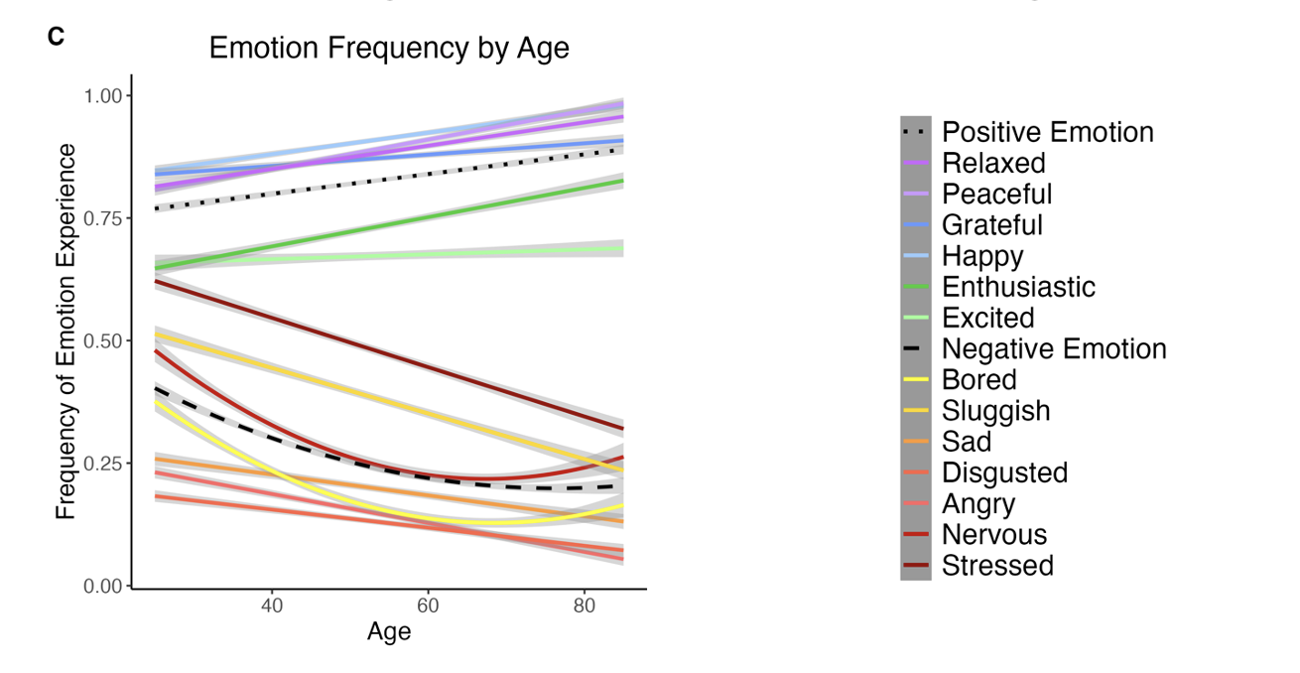
Emotions and Aging
Older adults show more positive emotions and less negative emotions than younger adults
Growney et al., 2025; Affective Science

Slide 5
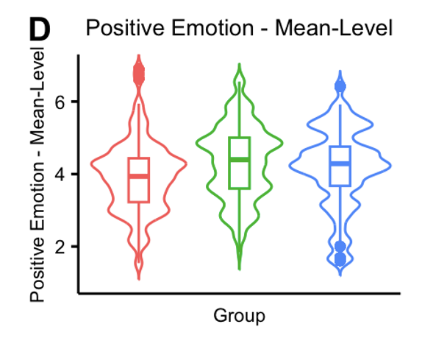
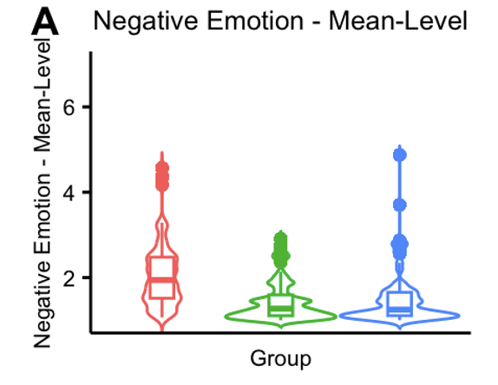
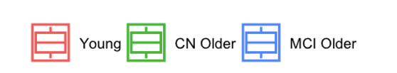
Emotions and Aging
Even older adults with Mild Cognitive Impairment (MCI) show more positive and less negative emotions than young adults
Growney et al., 2025; JGPS

Slide 6
Why do emotions become more stable and positive with age?
Do people just become “better” at emotion regulation with age?

Slide 7
Why do emotions become more stable and positive with age?
Do people just become “better” at emotion regulation with age?
It does not seem that simple (e.g., Isaacowitz, 2022)

Slide 8
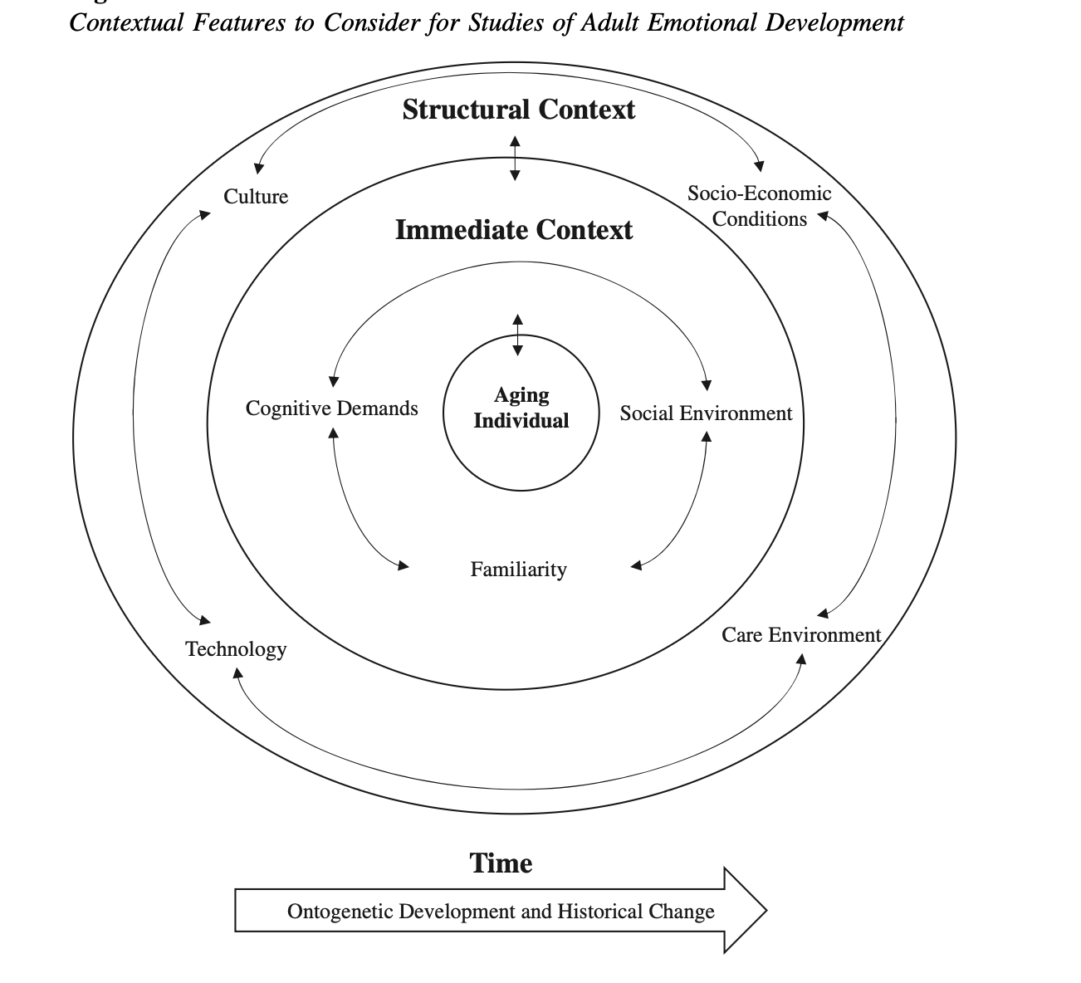
Why do emotions become more stable and positive with age?
Springstein et al., 2023; Psychology and Aging

Slide 9
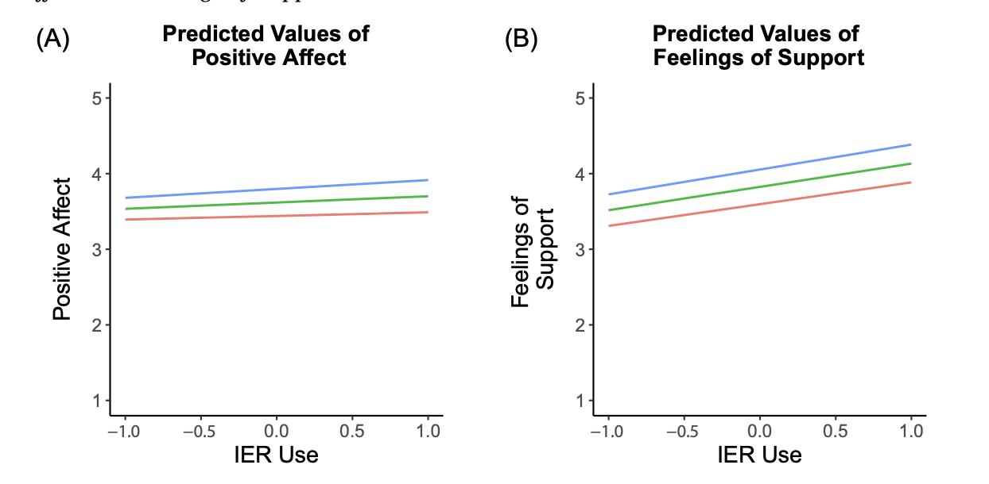
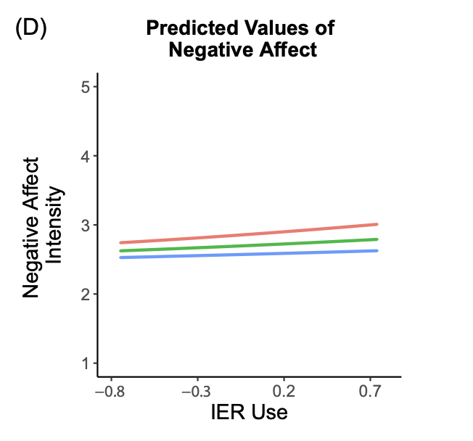

Emotion regulation with social partners
Springstein et al., 2024; Emotion

Slide 10
Emotion regulation with social partners
Older adults appear similarly effective as younger adults at regulating emotions with others
Springstein et al., 2024; Emotion

Slide 11
Capturing the Frequency of Emotion Regulation
Springstein & English, 2025; JGPS

Slide 12
Capturing the Frequency of Emotion Regulation
Older adults (regardless of cognitive status) regulate their emotions less frequently
Springstein & English, 2025; JGPS

Slide 13
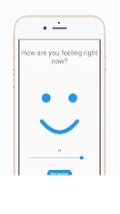
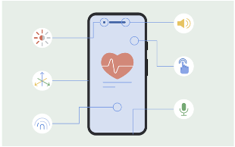



How do daily contexts enable less frequent emotion regulation with age?

Slide 14
Capturing daily context
Springstein et al., 2023; Psychology and Aging

Slide 15

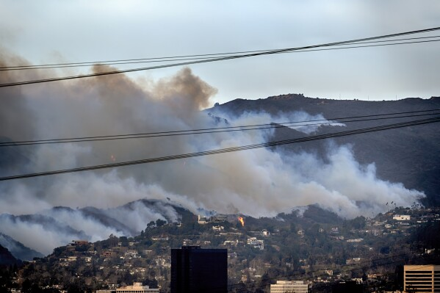

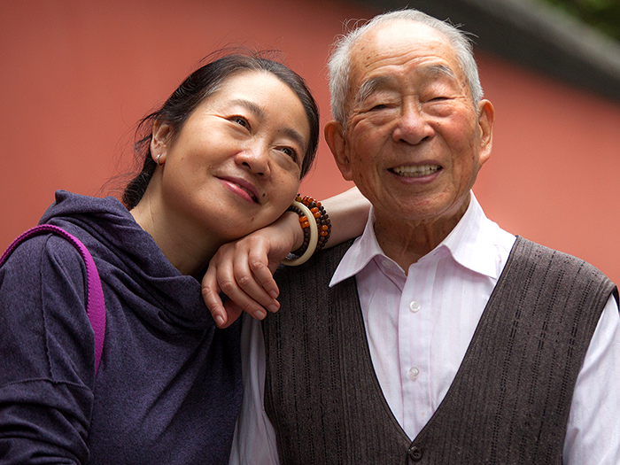
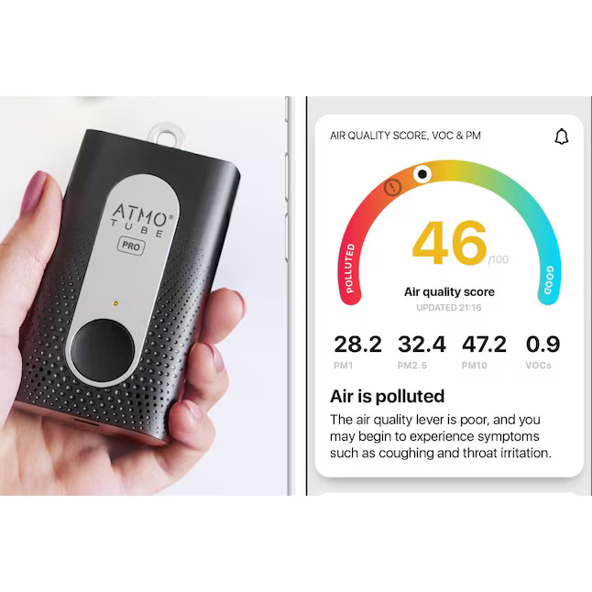
Capturing daily context

Slide 16

Talking to older adults about daily life research
Preliminary Qualitative Data
Amundsen et al., in prep

Slide 17
Talking to older adults about daily life research
Preliminary Qualitative Data
Potential issues
Skeptical of apps
Privacy concerns (tracking)
Time commitment
Amundsen et al., in prep

Slide 18
Talking to older adults about daily life research
Preliminary Qualitative Data
Potential issues
Potential incentives
Skeptical of apps
Giving back to society
Privacy concerns (tracking)
Showing the daily life of “my people”
Time commitment
Understanding how data is used
Amundsen et al., in prep

Slide 19
Questions?
Get in touch: tabea.springstein@ucr.edu

